Slide 1
Chapter 16
Anomaly detection
Problem motivation
It’s mainly for unsupervised learning problem, but there’s some aspects of it that are also very similar to sort of the supervised learning algorithm.

Slide 2
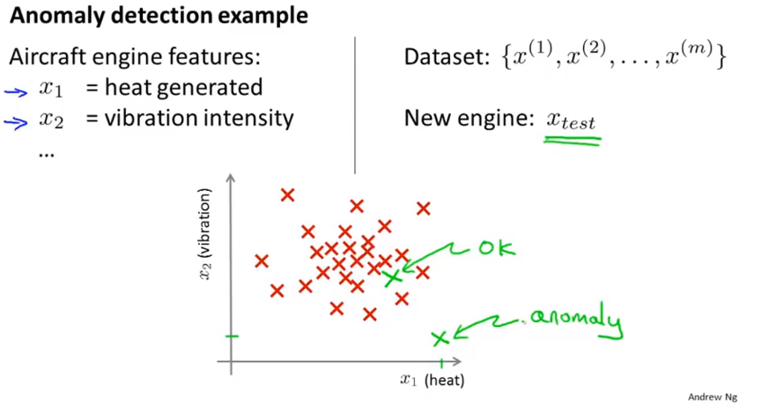
Chapter 16

Slide 3
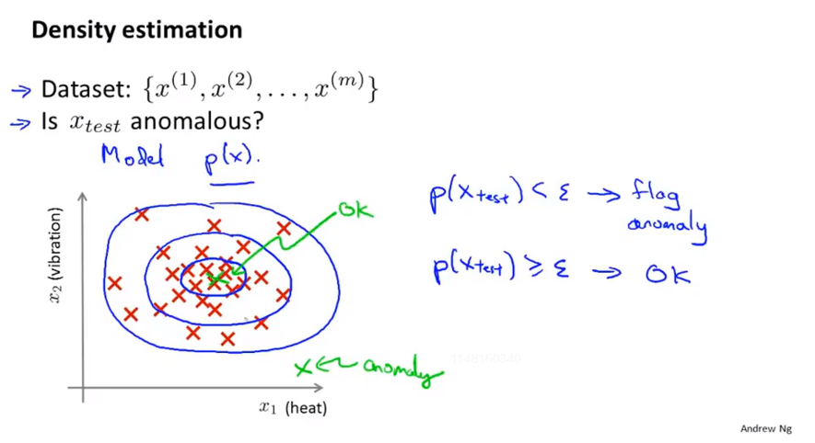
Chapter 16
We’re going to build a model for p of x, for the probability of x, where x are these features.
Epsilon threshold

Slide 4
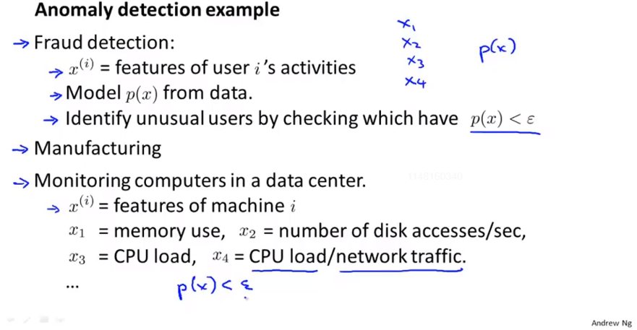
Chapter 16
This sort of technique will tend to flag the users that are behaving unusually, not just users that maybe behaving fraudulently. So not just constantly having stolen or users that are trying to do funny things, or just find unusual users. But this is actually the technique that is used by many online websites that sell things to try identify users behaving strangely that might be indicative of either fraudulent behavior or of computer accounts that have been stolen.

Slide 5
Chapter 16
Anomaly detection
Gaussian distribution
Also called the normal distribution

Slide 6
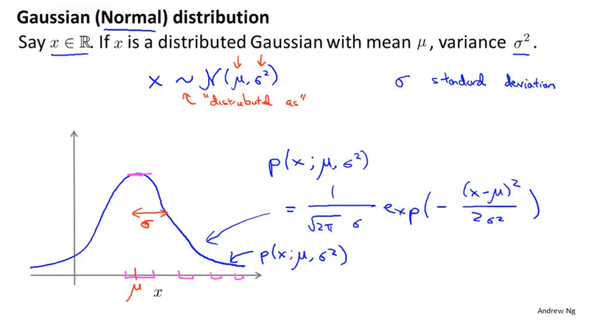
Chapter 16
Tilde read as distributed as | sigma one standard deviation it specifies the width of this Gaussian probability density whereas square of sigma is called the variance.

Slide 7
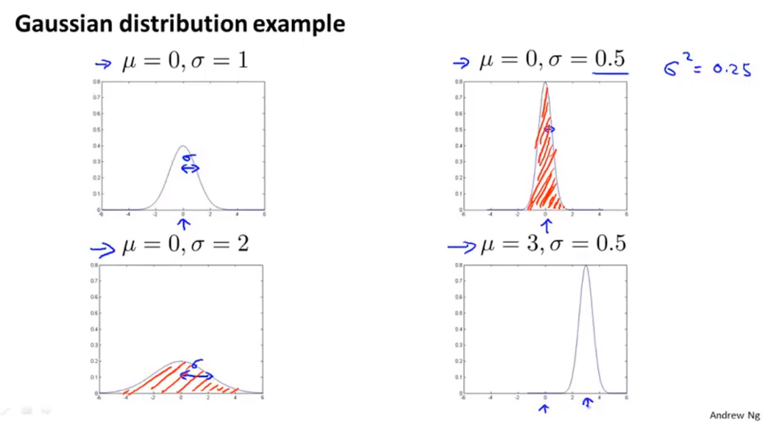
Chapter 16
The area under the curve, that is this shaded area, it always integrates to 1. That’s a property of probability distributions.

Slide 8
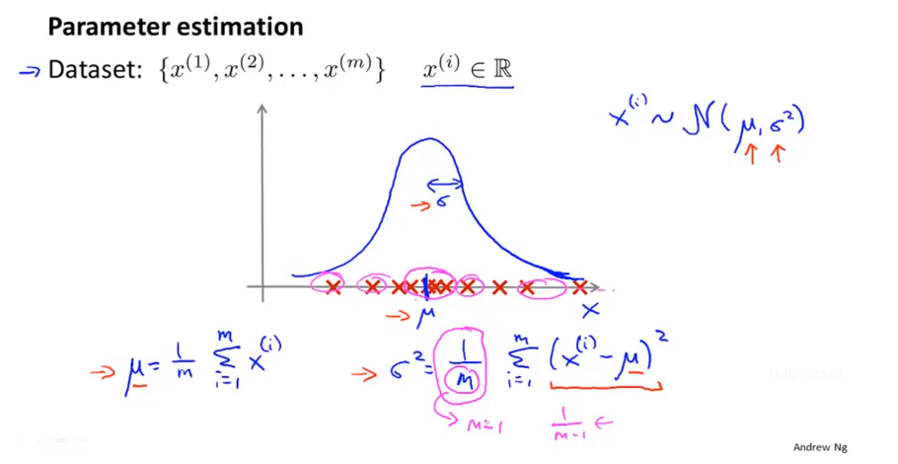
Chapter 16
Variance. That’s the square difference between the value I’ve got in my example minus the mean, minus the center, minus the mean of distribution, just the average square between my example, minus the mean.
Maximum likelihood estimation. Then these estimates are actually the maximum likelihood estimates
of the parameters of Mu and sigma squared.

Slide 9
Chapter 16
Anomaly detection
Algorithm

Slide 10
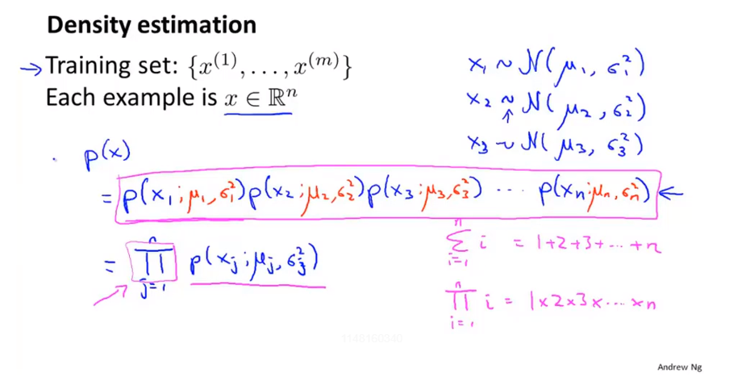
Chapter 16
Problem of
This equation actually corresponds to an independence assumption on the values of the feature x1 through xn. But in practice it turns out that the algorithm I’m gonna describe it works just fine, whether or not these features are anywhere close to independent and even if independence assumption doesn’t hold true this algorithm works just fine.

Slide 11
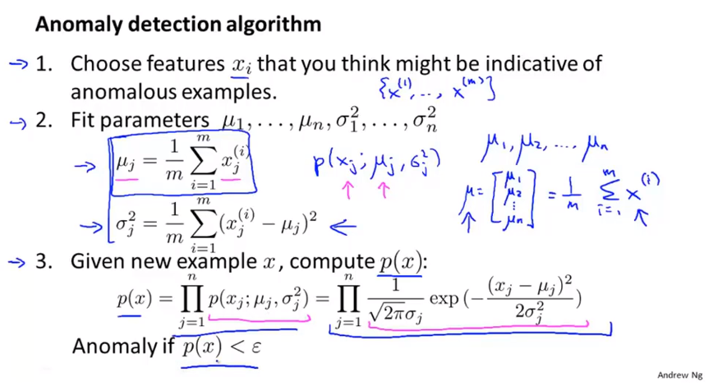
Chapter 16

Slide 12
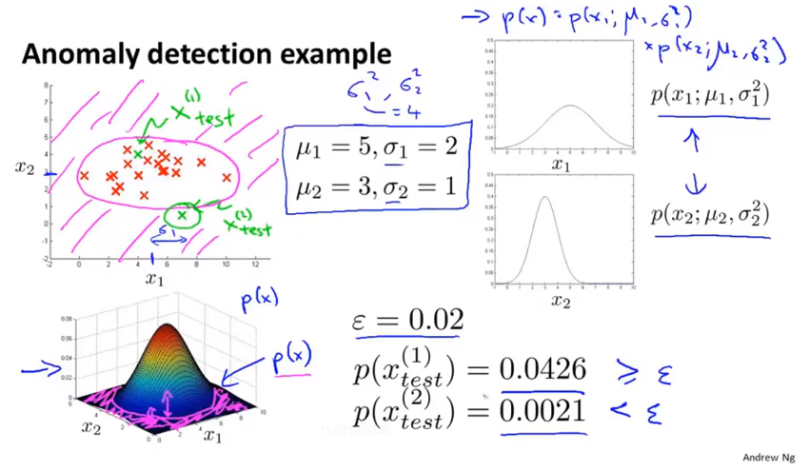
Chapter 16
P is the height of point(x1,x2)

Slide 13
Chapter 16
Anomaly detection
Developing and evaluating an anomaly detection system

Slide 14
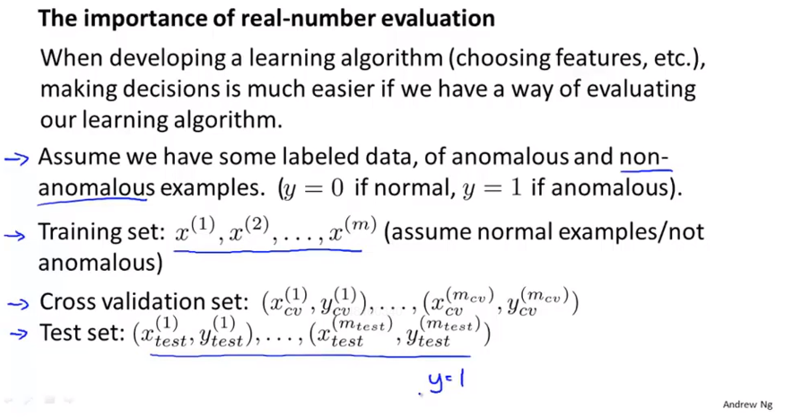
Chapter 16
It’s important to have a real number to evaluate whether we should add one feature or not.
It’s actually ok even if a few anomalies slip into your unlabeled training set.
Cross validation/Test set include some examples that are known to be anomalous.

Slide 15
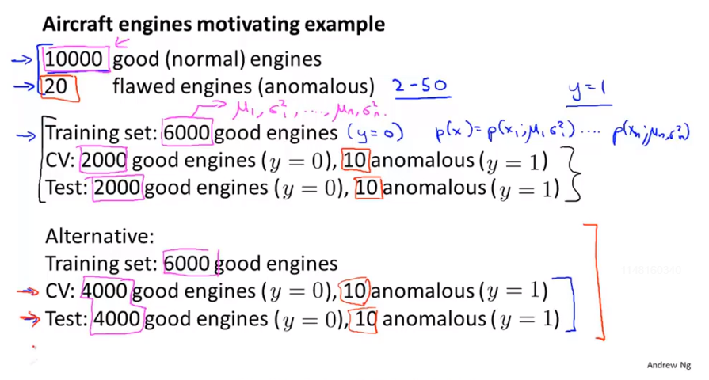
Chapter 16
Cross validation set and the test set as being completely different data sets to each other.

Slide 16
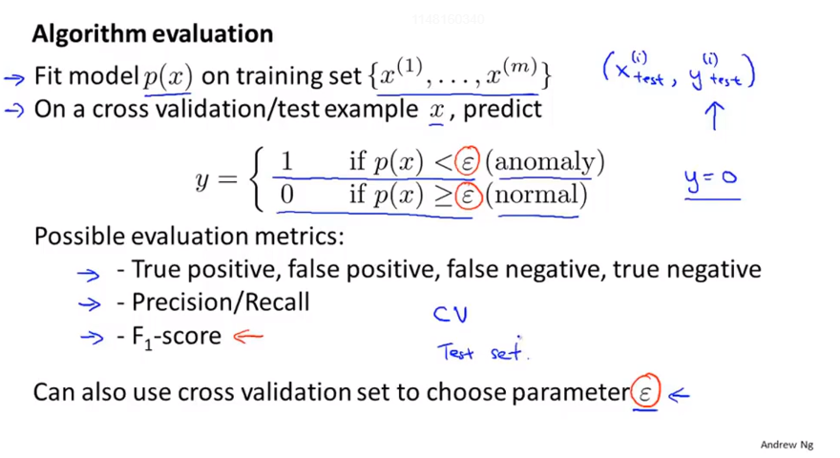
Chapter 16
Choose a epsilon that maximum F1-score.
We start to use a bit of labeled data in order to evaluate the anomaly detection algorithm and this takes us a little bit closer to supervised learning setting.

Slide 17
Chapter 16
Anomaly detection
Anomaly detection vs. supervised learning
Why we do not just use logistic regression or a neural network to try to learn directly from our labeled data to predict whether y equals 1 or y equals 0 ?
In this video, I’ll try to share with you some of the thinking and some guidelines for when you should probably use an anomaly detection algorithm and when it might be more fruitful to consider using a supervised learning algorithm.

Slide 18
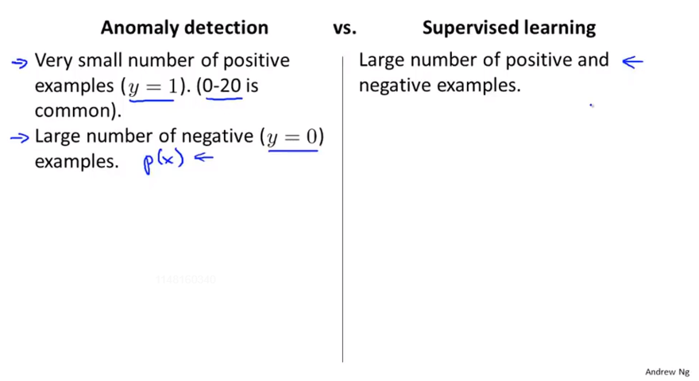
Chapter 16
0-20 maybe 50
Saved only for Cross Validation Set and test set.

Slide 19
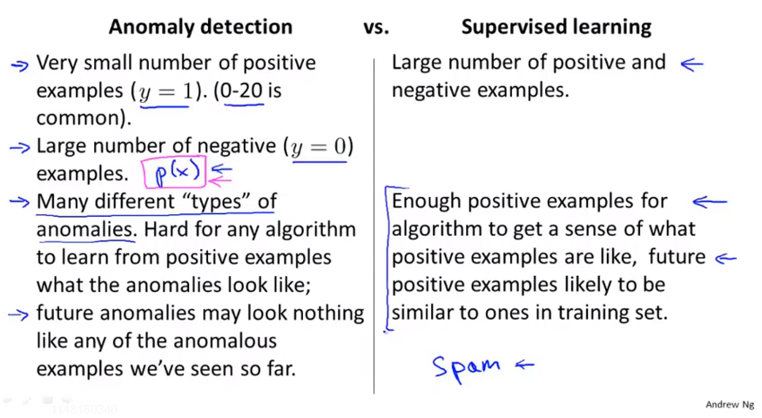
Chapter 16
And the key difference really is that, in anomaly detection, often we have such a small number of positive examples that there is not possible for a learning algorithm to learn that much from the positive examples. And so what we do instead, is take a large set of negative examples, and have it just learned a lot, learn p of x from just the negative examples of the normal aircraft engines.
And we reserve the small number of positive examples for evaluating our algorithm to use in either the cross validation sets or the test sets.

Slide 20
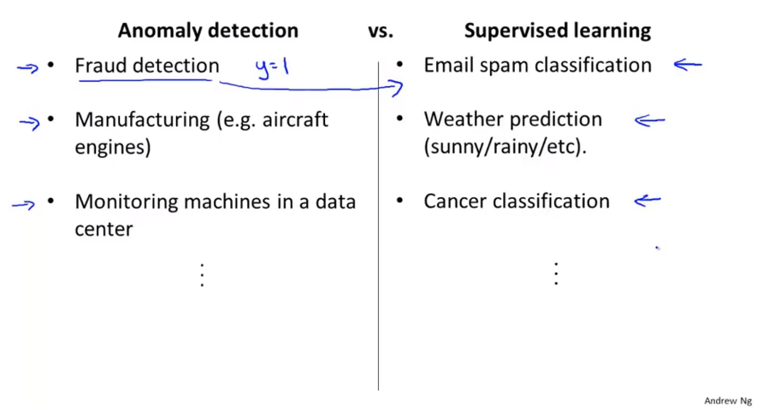
Chapter 16
If you’re manufacturing very large volumes and you’ve seen a lot of bad examples, Maybe manufacturing could shift to supervised learning column as well. But if you haven’t seen that many bad examples of the old products, the we’ll do this anomaly detection.
If you have equal number of positive examples and negative examples, if you have many examples of your positive and your negative examples, and then we tend to treat all of these as supervised learning problems.
Hopefully, this give you the sense what are the properties of a learning problem that would cause you to treat it as anomaly detection problem, verses a supervised learning problem.

Slide 21
Chapter 16
Anomaly detection
Choosing what features to use
Guidelines for how to go about designing or selecting features to give to an anomaly detection algorithm

Slide 22
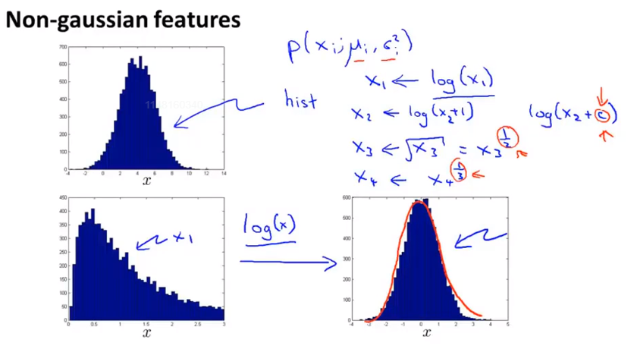
Chapter 16

Slide 23
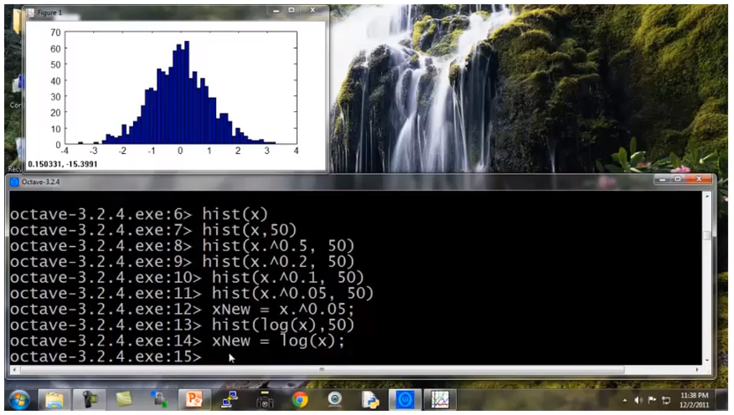
Chapter 16

Slide 24
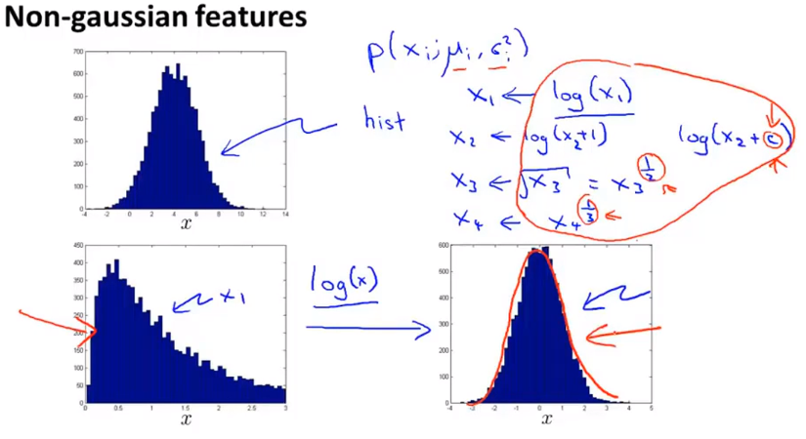
Chapter 16
So to summarize, if you plot a histogram with the data and find that it looks pretty non-Gaussian. It’s worth playing around a little bit with different transformations like these, to see if you can make your data look a little bit more Gaussian before you feed it to your learning algorithm. Although even if you don’t, it might work okay. But I usually do take this step.

Slide 25
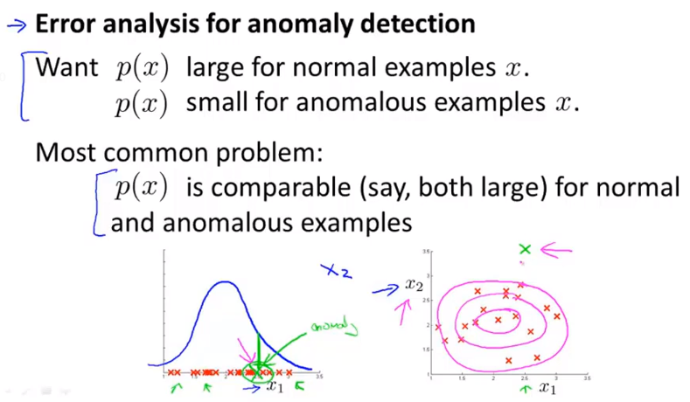
Chapter 16 process of error analysis
And so, the process of this is really look at the mistakes that it is making, Look at the anomaly that the algorithm is failing to flag and see if that inspires you to create some new feature. So that with this new feature it becomes easier to distinguish the anomalies from your good examples.

Slide 26
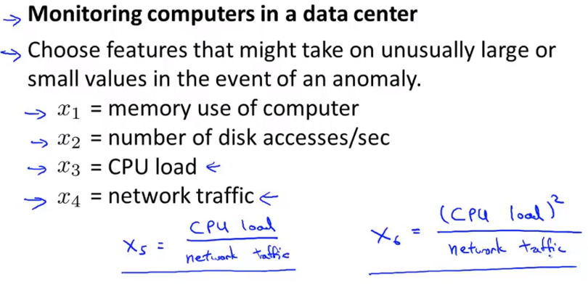
Chapter 16
By creating features like these, you can start to capture anomalies that correspond to unusual combinations of values of features.

Slide 27
Chapter 16
Anomaly detection
Multivariate Gaussian distribution
It has some advantages and some disadvantages and it can sometimes catch some anomalies that the earlier algorithm didn’t.

Slide 28
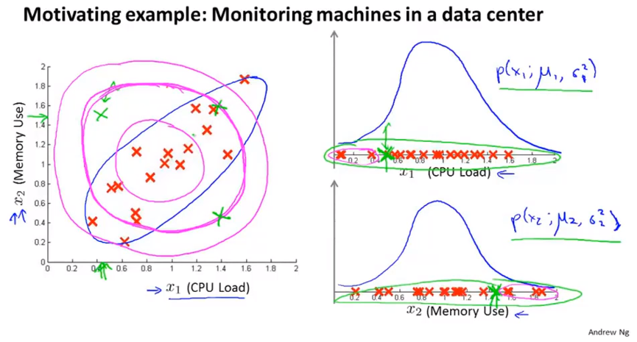
Chapter 16
Anomaly detection algorithm is not realizing that this blue ellipse shows the high probability region.

Slide 29
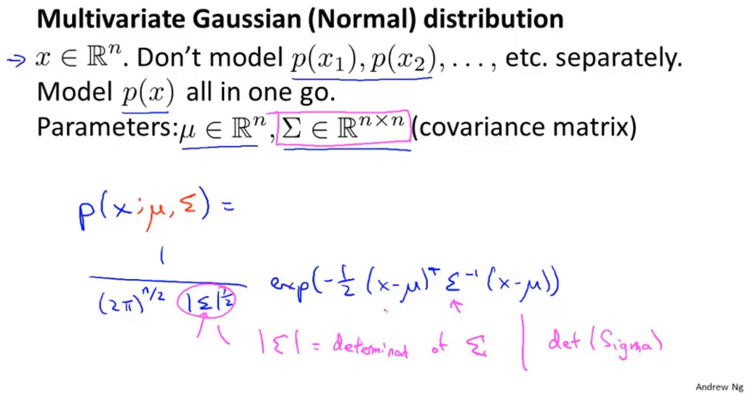
Chapter 16
Covariance matrix is similar to the covariance matrix that we saw when we were working with PCA.
Determinant 行列式

Slide 30
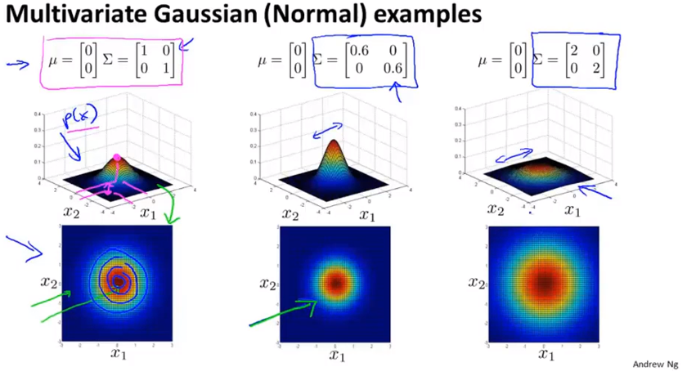
Chapter 16
Contour plot

Slide 31
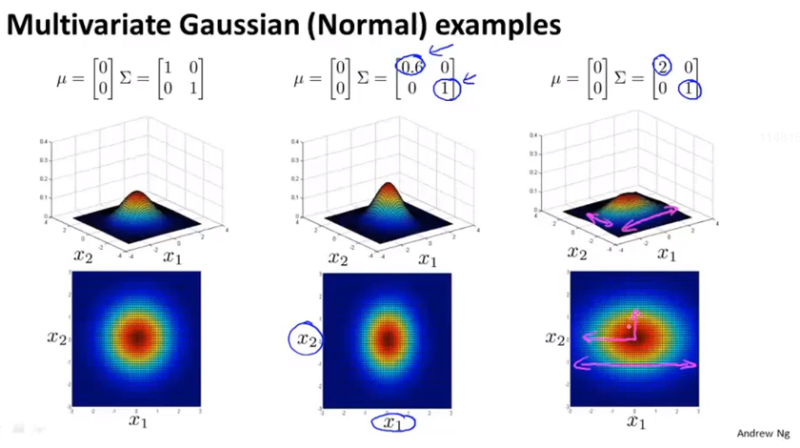
Chapter 16

Slide 32
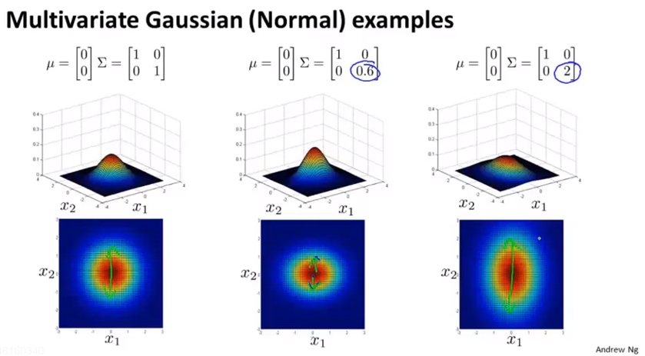
Chapter 16

Slide 33
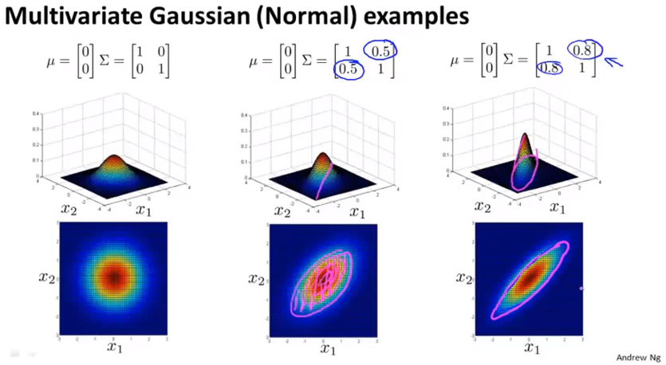
Chapter 16

Slide 34
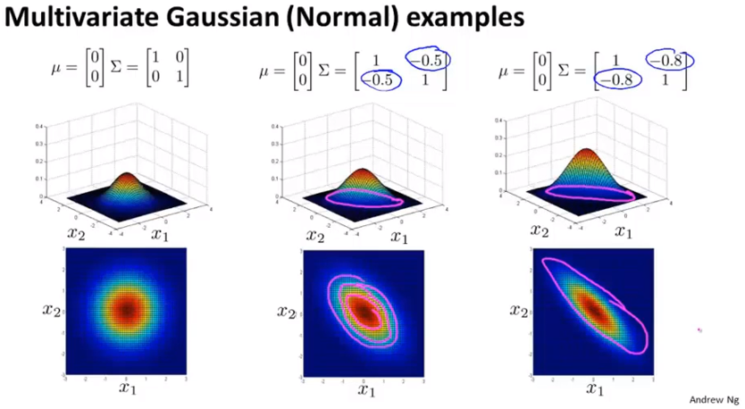
Chapter 16

Slide 35
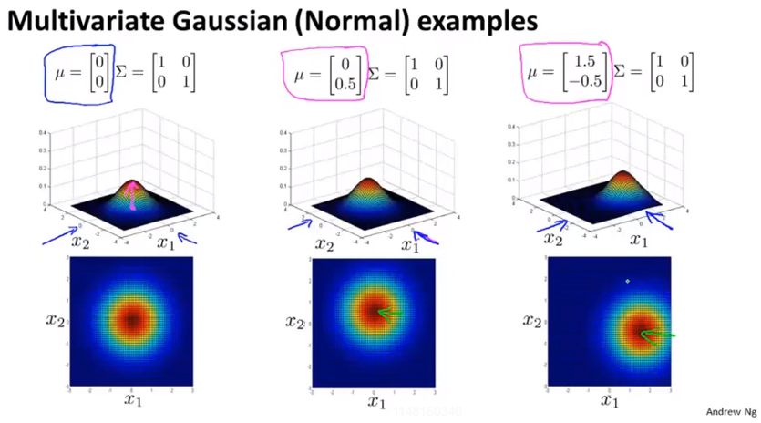
Chapter 16
The key advantages is it allows you to capture when you’d expect two different features to be positively correlated, or maybe negative correlated.

Slide 36
Chapter 16
Anomaly detection
Anomaly detection using the multivariate Gaussian distribution

Slide 37
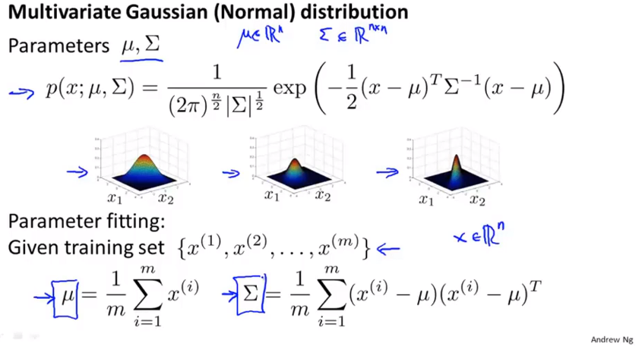
Chapter 16

Slide 38
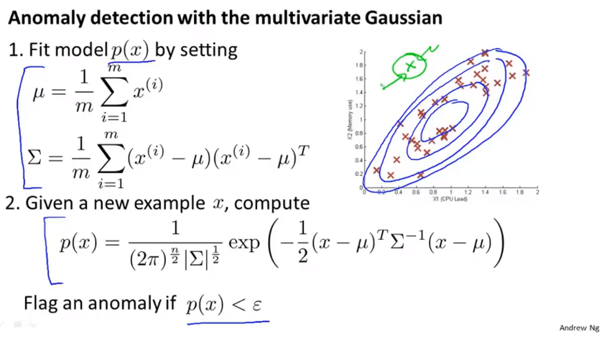
Chapter 16

Slide 39
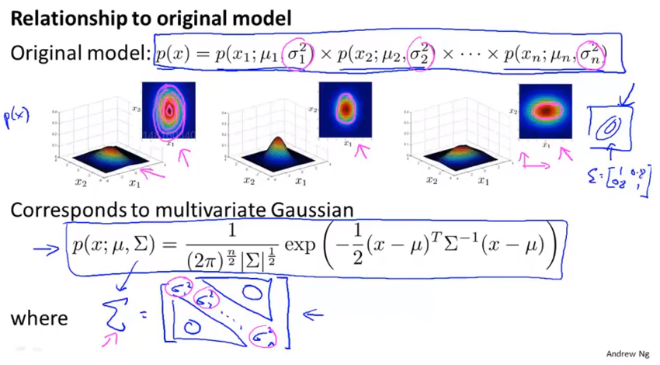
Chapter 16
If the covariance matrix sigma, has only 0 elements off the diagonals and in pictures, that corresponds to having Gaussian distributions where the contours of this distribution function are axis aligned. So you aren’t allowed to model the correlations between the different features. So in that sense the original model is actually a special case of this multivariate Gaussian model.

Slide 40
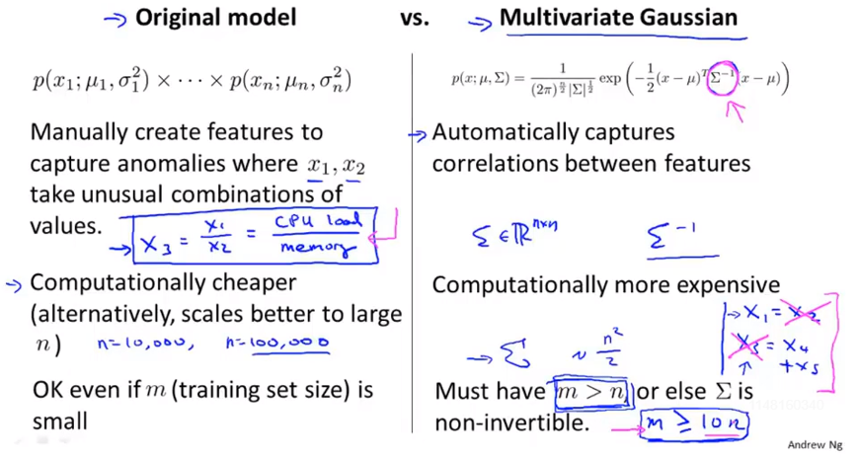
Chapter 16
redundant features
the formal term of these features that are linearly dependent
the odds of your running into this at all are pretty low

Slide 41
Chapter 16
So that’s it for anomaly detection with the multivariate Gaussian distribution. And if you apply this method, you would be able to have an anomaly detection algorithm that automatically captures positive and negative correlations between your different features and flag an anomaly if it sees is unusual combination of the values of the features.

